Slide 1


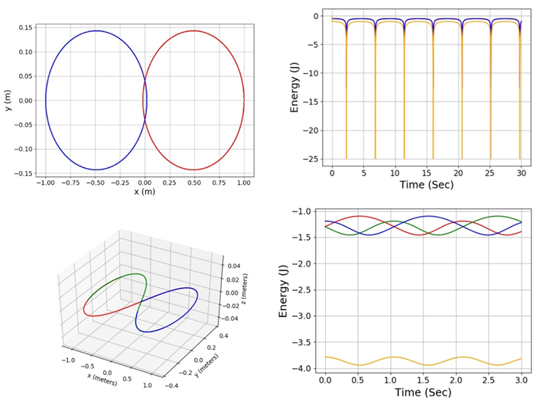
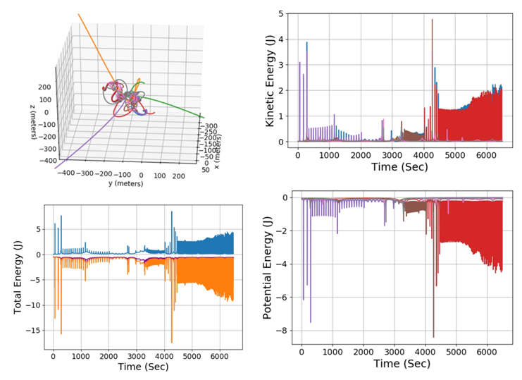
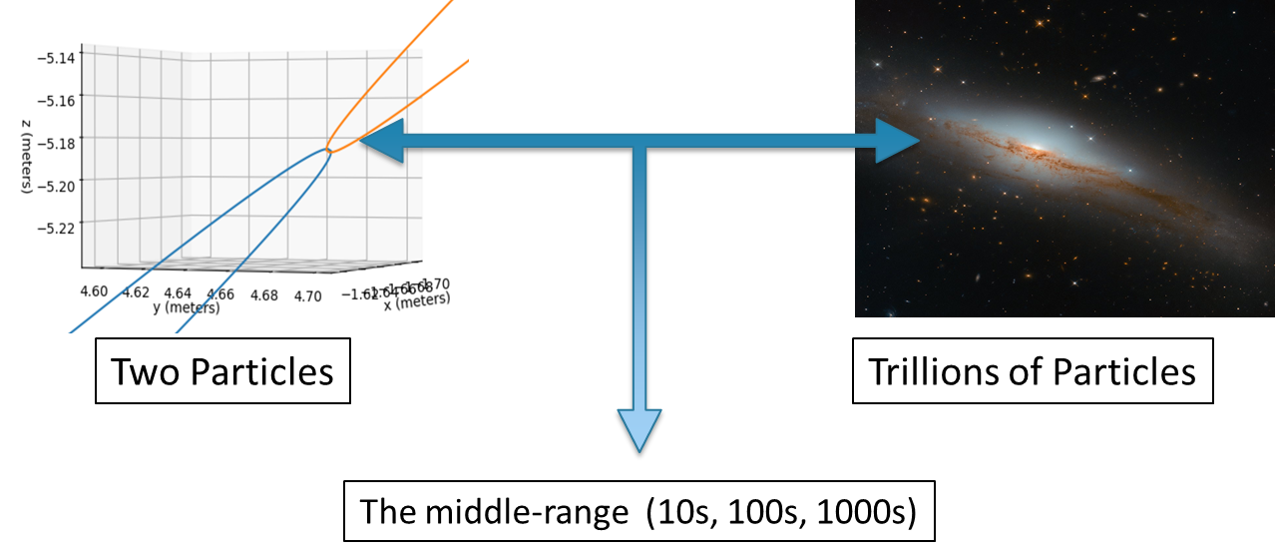
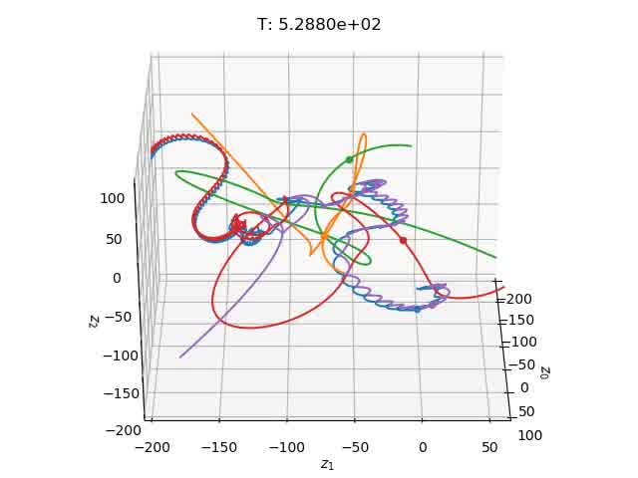
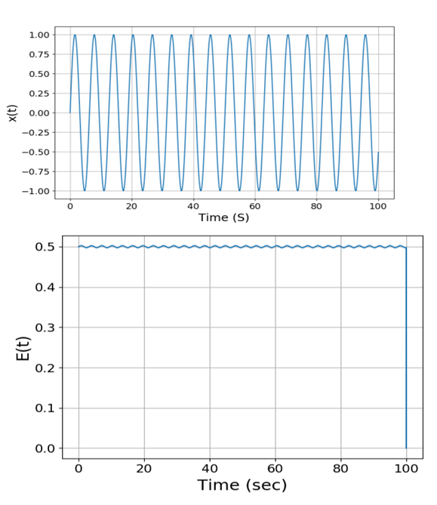
An Adaptive Symplectic Integrator for Modeling the Mechanics of Self-Gravitating Systems
Nishant Mishra, Advanced Research Computing Group
Institution: Princeton Plasma Physics Laboratory
Email: nmishra@college.harvard.edu
Introduction
Two/Three-Body Problem Tests
8-Body Distribution
The field of computational particle modeling has proven
imperative in initializing and controlling the motion of particles
in plasma machines like tokamaks and stellarators. Physicists
have obtained a firm understanding of smaller particle systems,
like the “Two-Body Problem”, as well as massive ones, from the
empirical data from galaxies. The gravitating systems of the
tens, hundreds, and thousands range, however, still introduce
an element of uncertainty. In order to better understand the
nature of these particle interactions, we decided to design a
symplectic integrator under the leapfrog scheme to model the
location and energies of self-gravitating systems.
To improve the accuracy of our integrator, we also implemented an adaptive time-stepping algorithm in our C code that reduces the time step whenever at least one particle is moving too fast and increases the time step whenever every particle is moving slowly. Finally, we worked to animate the plots, finally being able to demonstrate the motion of five of the particles in the eight-body test traversing about 330,000 data points in less than 10 seconds, giving users a reliable framework to observe the results of their simulations.
2- and 3-Body Location Plots
2- and 3-Body Energy Plots
8-Body Location Plot
8-Body KE/PE Plots
Location, KE, PE Key
Each curve represents the path/behavior of a different particle, with the eight different colors corresponding across the three plots
Location Plot Key
Each curve (Red, Green, Blue) represents the path/behavior of a different particle.
Total Energy Key
Orange/Green – Total Kinetic/Potential Energy
Blue - Combined Energy (Potential + Kinetic)
[1]
Total Energy Key
Orange/Green – Total Kinetic/Potential Energy
Blue - Combined Energy (Potential + Kinetic)
Next, the leapfrog integrator code was generalized to plot any number of bodies for a set time interval. As a test, eight particles of equal mass were distributed randomly within a 100-meter sphere and given random velocities within -.1 m/s to 0.1 m/s. The location plot reveals a couple of binary sub-systems and three particle ejections, and the “Combined Energy” curve (purple) in the “Total Energy” plot is fairly level, confirming the improved strength introduced by the adaptive time-stepping.
Next, it was decided to plots specific test cases of the two and three body problem under the leapfrog scheme (computed with C, plotted in Python). The computation was done between each pair of particles in the system, instead of relying on holistic system approximations, improving the accuracy of the program, while also increasing the computation time required to create the location and energy data files.
Integrator Weaknesses
Fixed time step (dt) makes it possible to miss finer levels of physical interaction when particles are near each other
“Total Energy” plot is sinusoidal instead of being constant
Hard-coded nature of this version of the code limits tests to two/three bodies
Animation Loop
Animated to model five of the particles in the eight-body system (~6.5k seconds, ~330k data points)
blue/purple particle binary gets separated by close interactions (~3.1k sec) and eventually yields a blue/red particle binary
Absence of pseudo-force commonly found in other integrators allows for the modeling of these binary captures/transfers
Animated 8-Body Location Plot (5 Particles)
Simple Harmonic Oscillator
To test the feasibility of using the leapfrog scheme, we started by modeling the motion and energy of a simple harmonic oscillator (SHM), modeled under a second-order leapfrog scheme. The position and energy of the plots were computed and plotted in Python. The location plot ended up being very accurate, but the energy plot was sinusoidal, instead of constant, marking a key characteristic in most adaptations of the leapfrog integrator^{[2]}.
Adaptive Time-Stepping Solution
SHM Location and Energy Plots
To circumvent the possibility of missing physical interaction with a time step that is too large, we decided to add an adaptive time-stepping algorithm to the original C code. The new algorithm computes three values each loop – the locations of the particle with the original time step, a doubled time step, and a halved time step.
If the distance between the locations of the halved time step and the original is too large -> the halved time step becomes the new default
Improves the accuracy of the integrator during close particle interactions
If the distance between the locations of the doubled time step and the original is too small -> the doubled time step becomes the new default
Helps speed up the computation time of the algorithm
Conclusions and Future Directions
Conclusion
A user-friendly, adaptive leapfrog integrator that can be used to simulate a wide range of self-gravitating systems consisting of large number of particles – useful for studying the statistical mechanics of gravitational/electromagnetic systems.
Future Directions
Swap out the Leapfrog scheme with other schemes (ex. Runge-Kutta) and compare the difference in location and energy plot
Determine the stability of stochasticity of systems in question – take each particle and add trace “ghost” particles that move under the influence of forces already existing in the system with slightly perturbed initial velocities.
References
Acknowledgements
[1]: ESA/Hubble & NASA, D. Rosario et al.
[2]: Time-Reversibility. (n.d.). Retrieved August 18, 2020, from http://www.physics.drexel.edu/~valliere/PHYS305/Diff_Eq_Integrators/time_reversal/
- Dr. Ammar Hakim for the hospitality, support and guidance he gave me during my time at PPPL
- Shannon Greco, who advised me on the logistics of the program.
- This work was made possible by funding from the Department of Energy for the PPPL High School Summer Internship program.

